Slide 1

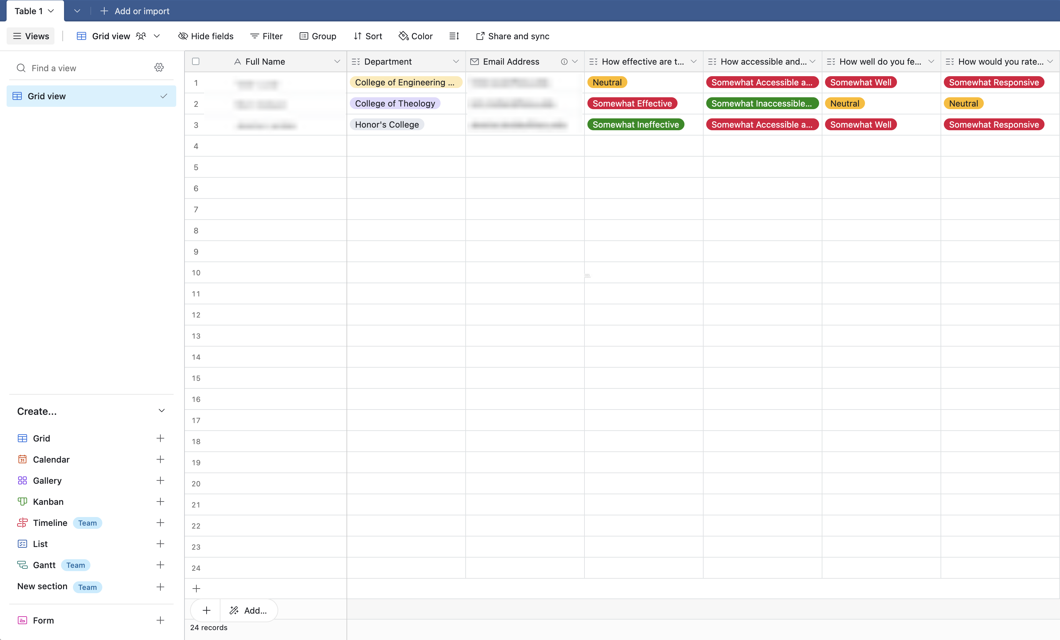

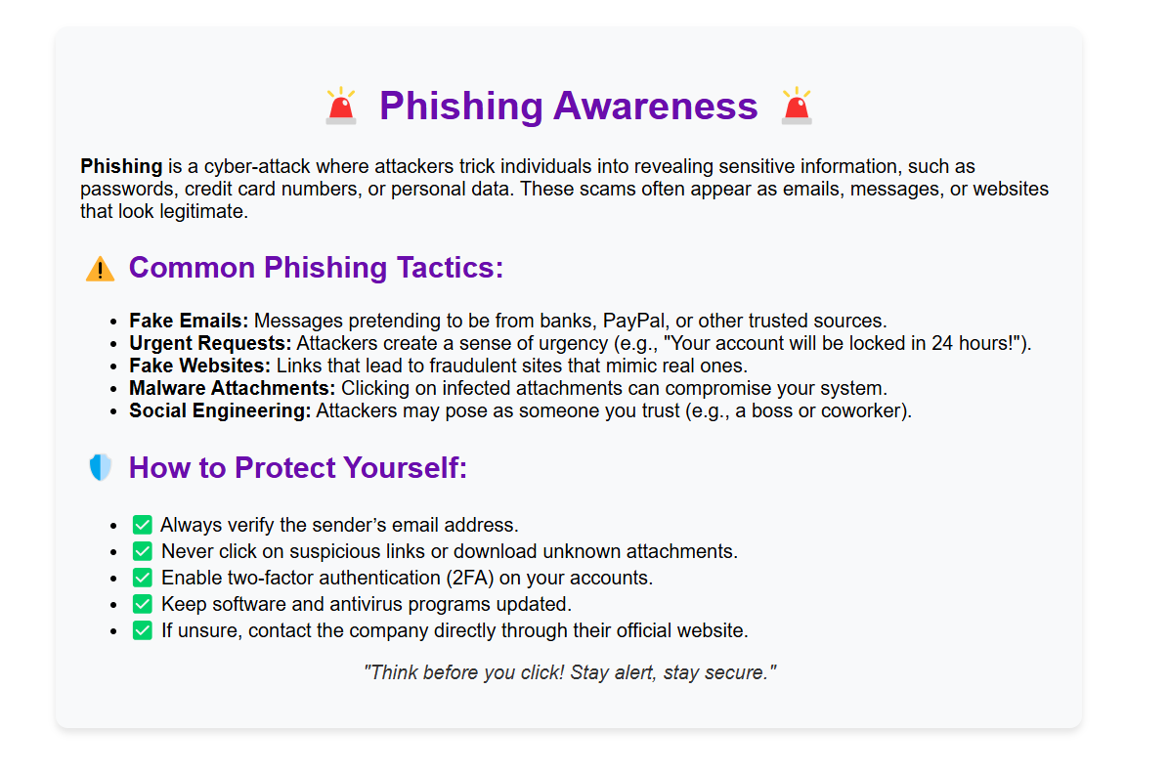
QR Code Social Engineering Campaign
Josie Parent, Richard Persaud, Luis Iriarte, Josh Bridges, Marvin Garcia, Christopher Arvizu, RJ Luea, and Jack Esposito
Vision Statement
Vision Statement
"Empowering individuals with the tools and knowledge to identify and combat cyber threats by delivering engaging and effective simulated phishing and baiting campaigns. The simulations emphasize the importance of safeguarding personal information and addressing human vulnerabilities in cybersecurity."​
Description
A simulated social engineering campaign to analyze the cybersecurity awareness of Grand Canyon University's faculty.
Implementing a simulated phishing campaign strengthens the company's cybersecurity posture by identifying vulnerabilities and improving employee awareness on the dangers of links and spreading information. Cyber threats, particularly phishing attacks, are among the leading causes of data breaches. By running this campaign, we reinforce best practices for recognizing phishing attempts.
Planning
OSINT
Creation
Distribution
Collecting
Analyzing
Presenting
Out of the 11 targeted colleges, only 17% scanned our QR code. Only three responses from non-student staff were recorded. Some colleges, like nursing, engineering, and technology, took the due diligence of taking down the QR codes within days of putting them up, while others stayed up for the week before coming back to take them down.
Results
Roles
Roles
Project Manager: Josie Parent
Cybersecurity Analyst: Richard Persaud
Graphics Designer: Luis Iriarte
Legal Counsel: Josh Bridges
Website Developer: Marvin Garcia
Data Analyst: Christopher Arvizu
Database Administrator: RJ Luea & Jack Esposito
Description
Justification
Database
Flyer
Process
Training

